Slide 1
New Unit: EVOLUTION

Slide 2
Evolution Continued: Adaptation Natural Selection & Artificial Selection

Slide 3
Natural Selection as the main mechanism for Evolution:
Three key sets of observations to explain this:
1. The struggle for existence
2. Natural variations among members of a species
3. The environment’s role in evolution

Slide 4
1. The struggle for Existence
Darwin noticed that all species tend to produce excessive numbers of offspring
But, resources are limited
So, the production of more individuals than the environment can support leads to a struggle for existence among the individuals of a population

Slide 5
2. Natural Variation
There is variation among the individuals of a population and the variation takes place over a long period of time
Variation refer to the differences among members of the same species (eg. look around in your classroom and notice differences in skin tone, hair colour, facial features)
Much of this variation is heritable

Slide 6
Darwin noticed that plants and animals in South America were quite distinct from species in Europe and Africa.
Related animal species that occupied different habitats within a local environment had different features. This was most obvious on islands (eg. Galapagos Island and the finches)

Slide 7
3. The role of the Environment
There are variations among members of a species and the environment selected for those variations that were best suited for that environment.
Contrary to Lamarck’s belief: Darwin would say that in a population of giraffes, some were born with short necks and some with long necks but the environment favoured the long neck giraffes so they survived and reproduced passing along their characteristics to the next generation

Slide 8
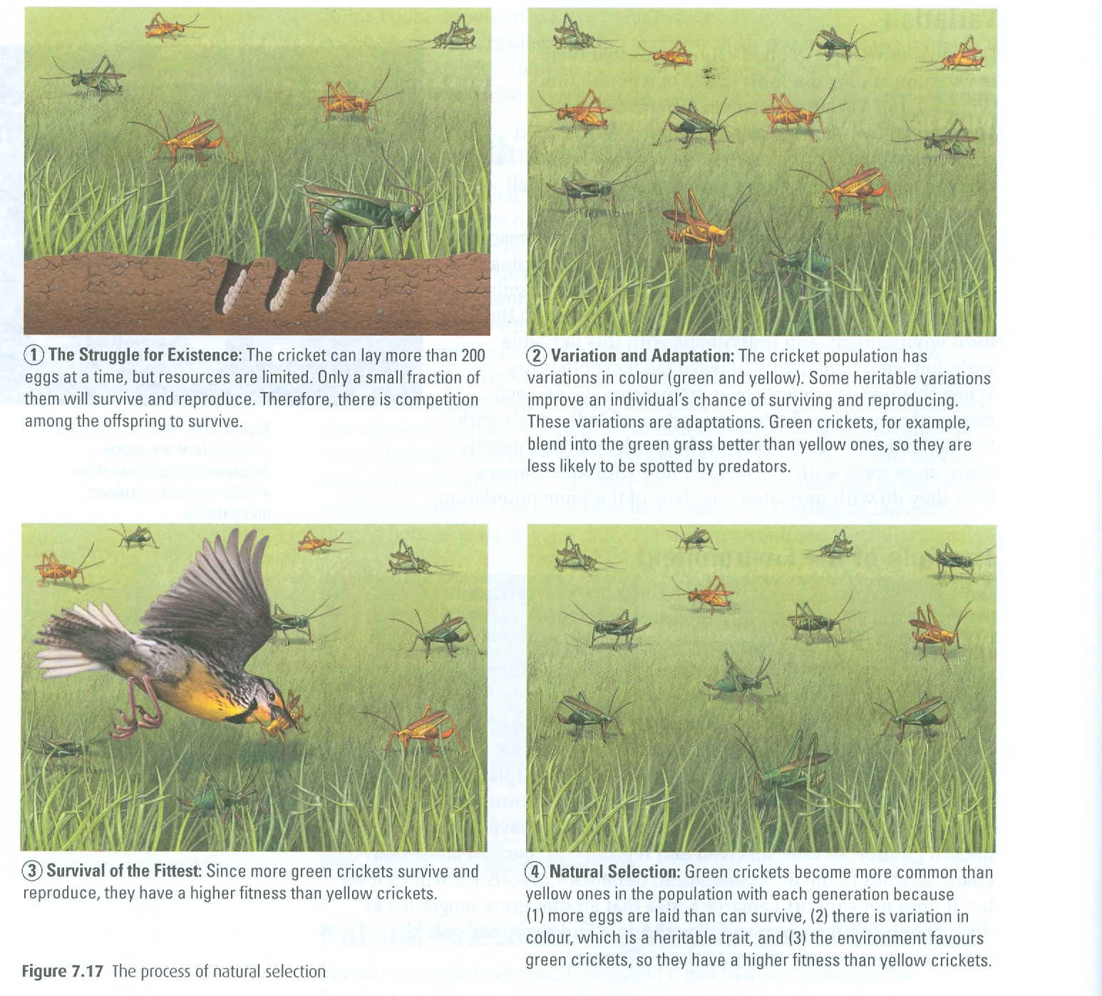

Slide 9
2 example cases for evidence of natural selection:
Finch Beaks Video
Antibiotic Resistance

Slide 10


Slide 11
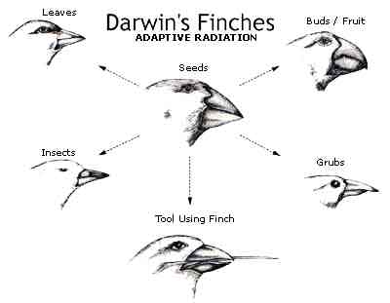
DARWIN’S FINCHES(pg 366):the common ancestor initially gave rise to several groups of finches. As time passed, populations within different groups became geographically and reproductively isolated from one another

Slide 12
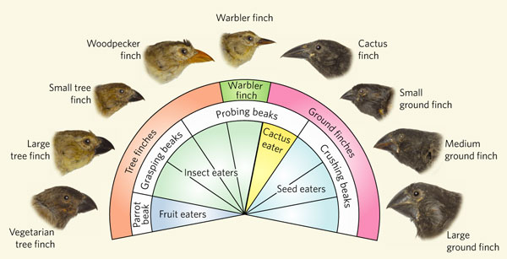

Slide 13
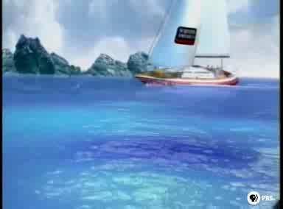

Slide 14
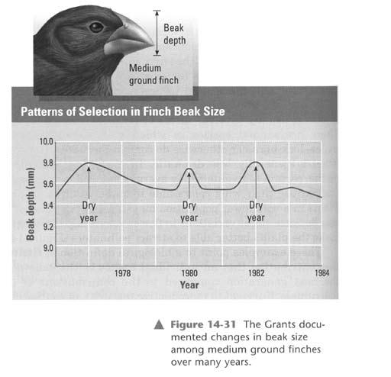

Slide 15
In the Galapagos Islands, finches evolved a variety of beak types adapted for cracking open different kinds of seeds.
Changes in weather patterns have been shown to change the kinds of seeds available—for example during drought, tough seeds that are difficult to crack are more abundant than soft seeds.
Finches with large beaks adapted for eating these hard seeds are more likely to survive and reproduce than other finches.
These finches become more abundant compared to those with small beaks.

Slide 16
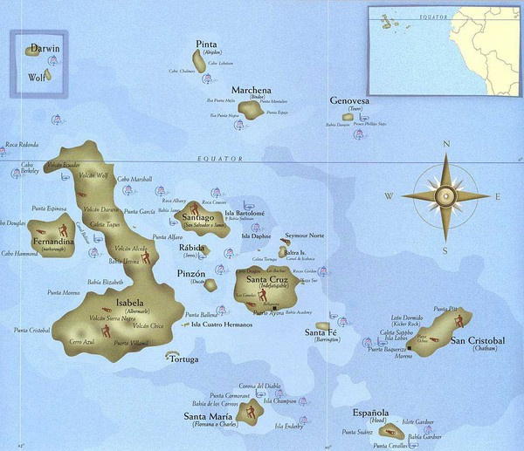
Galapagos formed from volcanoes
Different islands have different environments
Each island has its own species

Slide 17
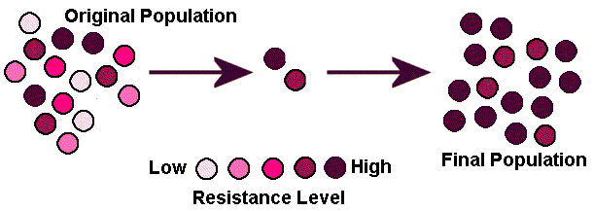
ANTIBIOTIC
RESISTANCE:
Antibiotics Introduced
The more resistant bacteria (containing resistant genes against the antibiotic) survive into the next generation and so on…)

Slide 18
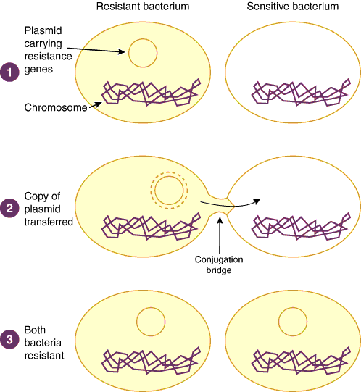
How do bacteria become resistant?

Slide 19
HOW DO BACTERIA BECOME RESISTANT TO ANTIBIOTICS?
Bacteria develop random mutations as they reproduce via successive generation. These random mutations could create a favourable gene (beneficial mutation). Let’s say it codes for a protein that protects the bacteria from antibiotics.
In particular environments (eg. Hospitals where antibiotics are often misused); bacteria with the beneficial mutation is favourably selected and is more fit to survive the next generation…
Since bacteria reproduce quick, more antibiotic resistant bacteria thrive.
Also, bacteria that contain the antibiotic resistant gene can share this information with ‘weaker’ bacteria through conjugation.

Slide 20
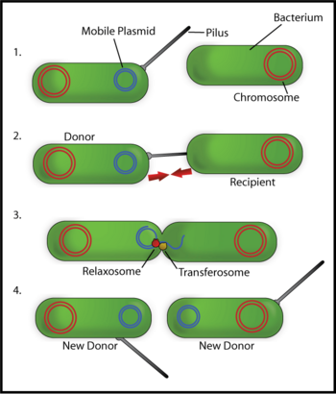
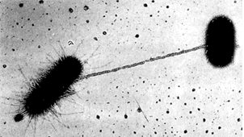
CONJUGATION

Slide 21
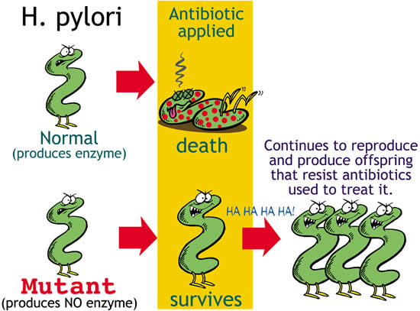

Slide 22
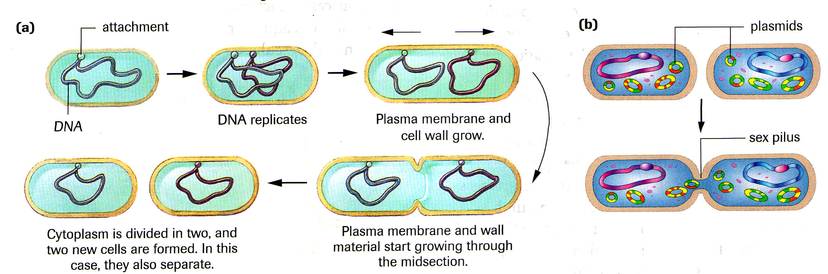
BINARY FISSION
CONJUGATION
Bacteria can reproduce by conjugation, or asexually by binary fission.

Slide 23
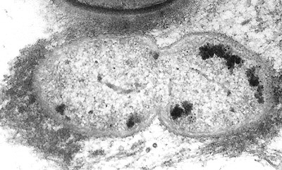
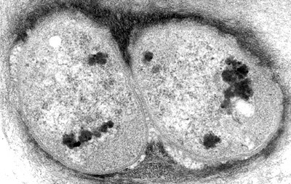
Some can reproduce every 20 minutes
(one bacteria could be an ancestor to one million bacteria in six hours)
BINARY FISSION
DIVISION COMPLETE

Slide 24
In Class
Read Activity 7.2 on page 302
TUBERCULOSIS: Adapting Populations of Bacteria
Complete and answer questions 1-4

Slide 25
Natural Selection vs Artificial Selection
Next Powerpoint

Slide 26
Other Important "Guys"
Read Section 8.1 and make notes on the following people:
  Buffon
  Cuvier (catastrophism)
  Lyell (uniformitarianism)
  Lamarck (inheritance of acquired characteristics)
  Wallace (survival of the fittest)
H/W: p. 331 #1, 4-6, 11, 12, 14

